Slide 1
Perceptron Branch Predictor Simulator
CMPUT 229 lab 6

Slide 2
Background:
Static Predictions VS Dynamic Predictions

Slide 3
Static Predictions
OR
Always Taken
Always Not Taken

Slide 4

Static Predictors
Simple design
Not very accurate
Cannot learn and adapt predictions based on program execution behavior

Slide 5
Dynamic Predictors
Prediction of a given branch changes with the execution of the program.
  Simple: a finite-state machine encodes the outcome of a few recent executions of the branch.
  Elaborate: Not only early branch outcomes, but other correlated parts of the programs are considered.

Slide 6
Predicting Direction
Where we find the prediction?
How to encode the prediction?
Look at the recent past: What was the direction the last time this same
branch was executed?
A single bit encodes the prediction: Prediction bit is set at prediction time.

Slide 7
1-Bit counter Dynamic Predictor
Table Entry | Branch Address (or tag) | Predictor State
0 | 0xFF80 0004 | 0
1 | 0xC340 00F8 | 1
 | …
n | 0x0004 0000 | 1

Slide 8
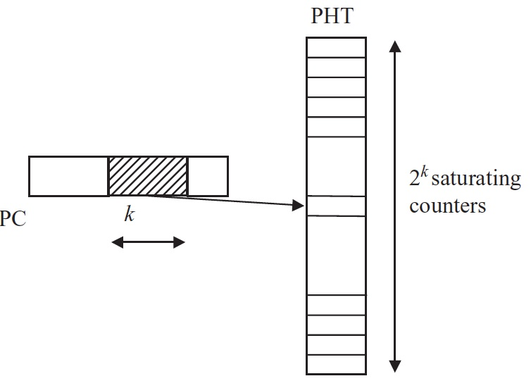
Counters Stored in Pattern History Table (PHT)
Use PC to index (or hash) the PHT.
Each entry of the PHT
stores the state of the counter
associated with a branch.

Slide 9
1-Bit counter Dynamic Predictor Example
PC | 1-bit counter | Prev. Outcome | Prediction | Actual Outcome
0x00400030 | 1 | Taken | Taken | Taken ✅
0x00400080 | 0 | Not Taken | Not Taken | Not Taken ✅
0x0040008c | 0 | Not Taken | Not Taken | Taken❌ (mispred.)
After the actual result of the branch is determined, update the saturating counter.

Slide 10
1-Bit counter Dynamic Predictor Example
PC | 1-bit counter | Prev. Outcome | Prediction | Actual Outcome
0x00400030 | 1 | Taken | Taken | Taken ✅
0x00400080 | 0 | Not Taken | Not Taken | Not Taken ✅
0x0040008c | 1 | Taken
This branch will be predicted taken the next time it is fetched.

Slide 11
1-Bit counter Predictor Summary
The PC of a branch is used to index into a table of counters (PHT)
Each counter indicates whether that branch should be predicted Taken or Not Taken
The outcome of the branch depends on its previous outcome
This is known as a Local dynamic predictor

Slide 12
Local vs Global Predictors
Local: Predictions for a branch depend only on the past behaviour of that branch.
Global: Predictions for a branch depend on the behaviour of other branches.

Slide 13
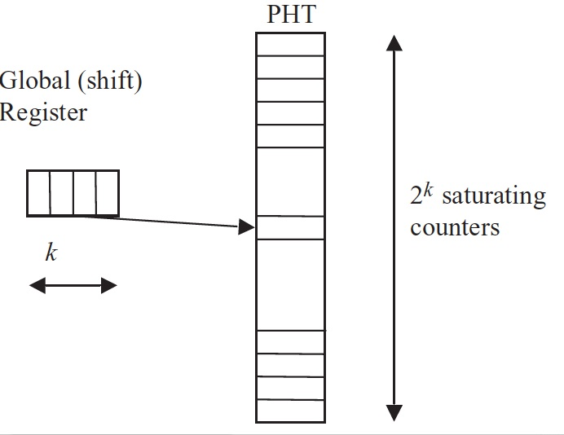
Global Predictor
Shifted-out bits
are lost
1 inserted to the
right when a branch
is taken (0 otherwise)

Slide 14
8-Bit Global Shift Register (GSR)
0 | 1 | 1 | 1 | 0 | 1 | 0 | 1
Oldest branch outcome shifted out
Most recent branch outcome shifted in
1 = Taken
0 = Not Taken

Slide 15
8-Bit Global Shift Register (GSR)
0 | 1 | 1 | 1 | 0 | 1 | 0 | 1
Tracks the history of the 8 most recent branches

Slide 16
Global Predictor Summary
The bits of the global shift register are used to index into a table of counters (PHT)
Each counter indicates whether the current branch should be predicted Taken or Not Taken
The outcome of the branch depends on global branch history
Predictions for current branch are independent of its PC

Slide 17
Perceptron Branch Predictor
Uses both local and global branch history information to make predictions
Uses simple binary classification to learn complex branch patterns and correlations
Increased accuracy in many applications

Slide 18
What is a Perceptron?
One of the simplests forms of neural networks
Binary classifier
A set of weights, where each weight is a measure of importance that each input value has to the output

Slide 19
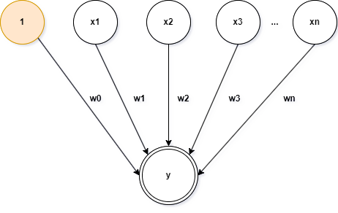

Input
Weights
y
Output

Slide 20
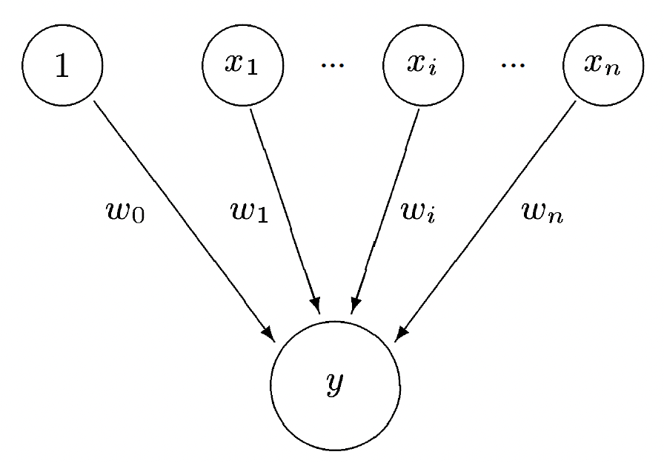
GSR Used for Perceptron Predictor
Global Shift Register
Global shift register bits are the input values

Slide 21
Global Shift Register
+1 if branch is taken
⋅⋅⋅
⋅⋅⋅
-1 if branch is not taken
bias input
Multiply
w₀ > 0: bias taken
w₀ < 0: bias not taken
Predict taken if positive, not taken if negative

Slide 22
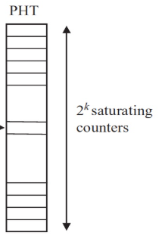
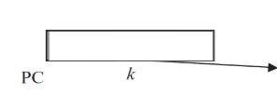
PHT for Perceptron Predictor
Each PHT entry now holds a set of weights associated with the branch identified by its PC.
[w0, w1, w2, ..., wn]

Slide 23
Making a Prediction
Dot product:

Slide 24
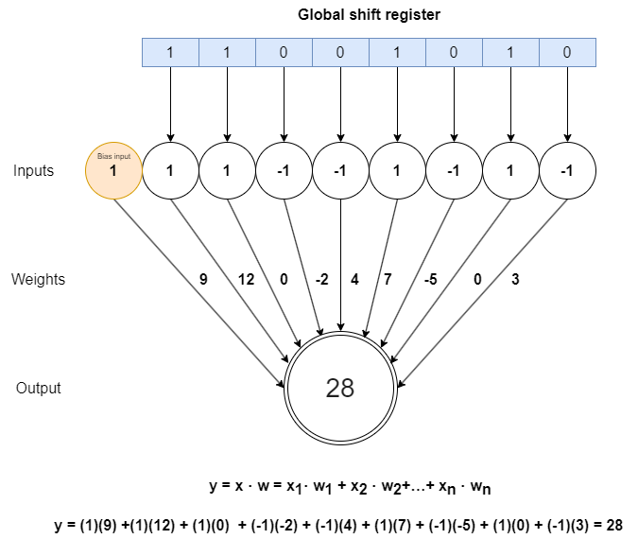

Slide 25
Branch predicted taken!

Slide 26
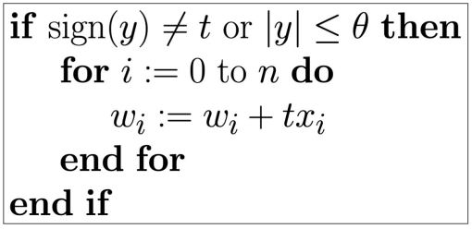
Training a Perceptron

Slide 27
Update weights after actual outcome of branch is determined
w_{i} = w_{i} + tx_{i}
1 if branch was taken
Actual Outcome of the Branch:
t =
-1 if branch was not taken

Slide 28
The perceptron weights are updated based on the actual branch outcome

Slide 29
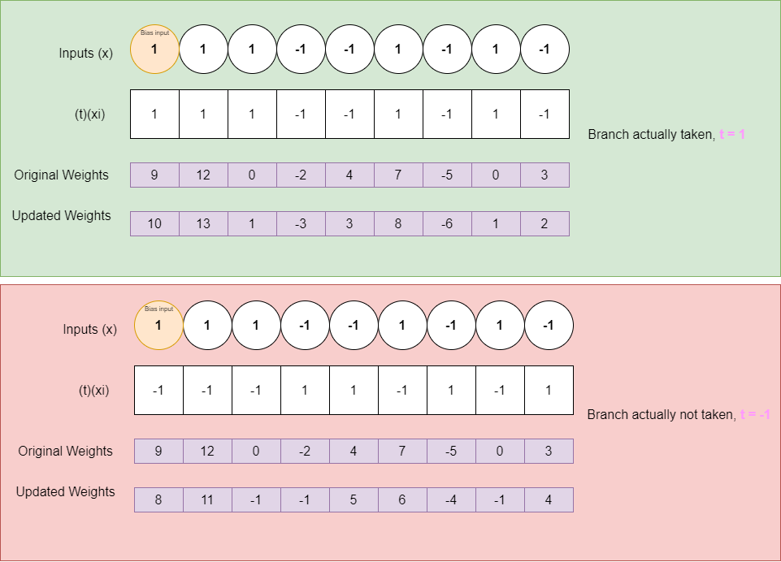
Case 1: Branch is actually taken ✅
w_{i} = w_{i} + tx_{i}

Slide 30
Case 2: Branch is actually not taken ❌
w_{i} = w_{i} + tx_{i}

Slide 31
When to Stop Training?

Slide 32
Threshold 𝚹
Intuition
When the value y becomes high,
the branch has a strong bias.
No need for further training.
Stop training is |y| > 𝚹.

Slide 33
Perceptron branch predictor in RARS

Slide 34
Similar to the the coding question on the midterm, perceptron_predictor.s reads and parses the binary of another program provided as an argument.

Slide 35
perceptron_predictor.s will predict the branches in the input program, and train its perceptrons on the actual branch outcomes.

Slide 36
Unlike an actual perceptron branch predictor, the one in this lab will not use the PC of a branch to access the PHT. Instead each branch from the input program will be assigned a static branch Id.

Slide 37
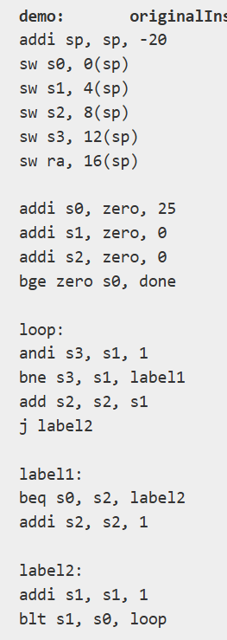
Input Program
Branch Id 0
Branch Id 1
Branch Id 2
Branch Id 3

Slide 38
PHT for the Lab
The PHT is represented as an array of words in this lab, indexed by branch Id.
PHT
Branch Id 0
[w0, w1, w2, ..., wn]
Branch Id 1
[w0, w1, w2, ..., wn]
Branch Id 2
[w0, w1, w2, ..., wn]
…

Slide 39
makePrediction
Description:
Makes a prediction on whether a particular branch will be taken or not taken,
given the program state and branch Id
Arguments:
a0: Branch id
Returns:
None

Slide 40
trainPredictor
Description:
Trains the perceptron corresponding to the branch id stored in activeBranch.
Arguments:
a0: Actual branch outcome (1 if taken, else -1)
Returns:
None
activeBranch: A 1-byte global variable that holds the branch Id of the current unresolved branch.

Slide 41
Instrumentation

Slide 42
Unlike the midterm question, perceptron_predictor.s must modify the binary of the input program, then begin executing the instructions of the input program.

Slide 43
Why modify the input file’s binary?

Slide 44
The modifications to the input binary will include inserting jumps to the functions makePrediction and trainPredictor, before/after each branch.

Slide 45
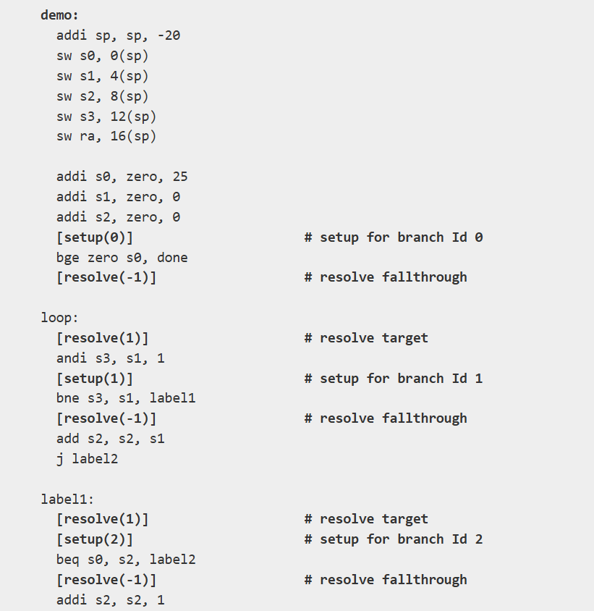
Input Program
The setup and resolve instructions have been inserted into the binary by perceptron_predictor.s

Slide 46
setup(branch id):
Calls makePrediction
resolve(-1):
Calls trainPredictor to indicate that the setup branch was not taken.
resolve(1):
Calls trainPredictor to indicate the setup branch was actually taken.

Slide 47
How to modify the input binary and execute it within perceptron_predictor.s?

Slide 48
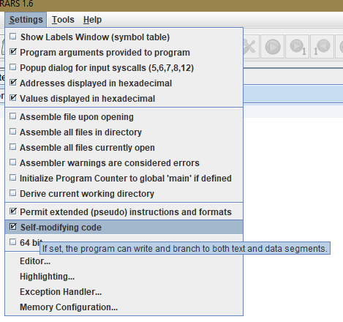
Self Modifying Code

Slide 49
With the self-modifying code feature enabled, your program can jump to the starting address of the input program’s modified binary, and begin executing those instructions.

Slide 50
Required Data Structures

Slide 51
globalShiftRegister: This is a 1-byte global variable. Each bit in globalShiftRegister corresponds to a previously taken branch.
patternHistoryTable: This global variable is an array of words that simulates a pattern history table. Each element is a pointer to the 9-byte long array of perceptron weights for the corresponding branch id.

Slide 52
instructionIndicatorsArray: A byte array where each byte acts as an indicator that a specific sequence of instructions must be inserted intomodifiedInstructionsArray.
numPriorInsertionsArray: An array of 32-bit words, where each word specifies the total number of instructions to insert before the corresponding instruction in the originalInstructionsArray.

Slide 53
originalInstructionsArray: An array that contains every instruction from the input function.
modifiedInstructionsArray: An array that contains the input function after the insertion of the instrumentation function calls.

Slide 54
Functions to Complete

Slide 55
perceptronPredictor
Description:
The primary function that initiates the instrumentation and execution stages.
This function must modify the input binary, train and run the predictor,
then print the results.
Arguments:
a0: Pointer to originalInstructionsArray
a1: Pointer to modifiedInstructionsArray
a2: Pointer to instructionIndicatorsArray
a3: Pointer to numPriorInsertionsArray
Returns:
None

Slide 56
fill_instructionIndicatorsArray
Description:
This function is responsible for filling instructionIndicatorsArray.
Arguments:
a0: Pointer to originalInstructionsArray
a1: Pointer to instructionIndicatorsArray
Returns:
None

Slide 57
fill_modifiedInstructionsArray
Description:
This function is responsible for filling numPriorInsertionsArray.
Arguments:
a0: Pointer to instructionIndicatorsArray
a1: Pointer to numPriorInsertionsArray
Returns:
None

Slide 58
makePrediction
Description:
Makes a prediction on whether a particular branch will be taken or not taken,
given the program state and branch Id
Arguments:
a0: Branch id
Returns:
None

Slide 59
trainPredictor
Description:
Trains the perceptron corresponding to the branch id stored in activeBranch.
Arguments:
a0: Actual branch outcome (1 if taken, else -1)
Returns:
None

